Slide 1
SCSC 509 Project Presentation
Brian Rankin
Spring 2013

Slide 2
Game
My app is a simple 2D game. The player drives a car down the road while avoiding traffic and other obstacles.
Player is positioned towards the bottom of the screen and drives upward to reach their goal.

Slide 3
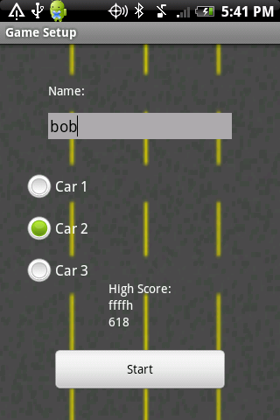
Setup
When the app is started, the player enters in their name and selects their car.
The cars are slightly different from each other, but for the most part, they are the same except for their graphic.
The current high score is also visible on this screen.

Slide 4

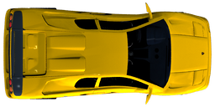
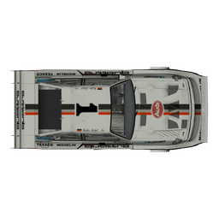
Cars Graphics made by “DravenX”. http://www.scirra.com/forum/free-sprite-pack-1_topic45944.html
Car 1 – Fastest, but doesn’t turn or accelerate as well
Car 2 – Most evenly balanced.
Car 3 – Has good acceleration and brakes, but not as fast

Slide 5
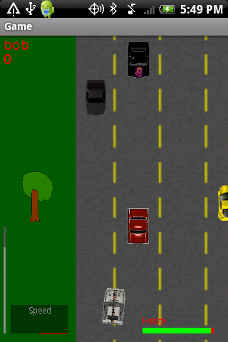
Gameplay
Once the game begins, the player starts on a road and must begin driving.
Crashing into other vehicles will damage the car. If the player takes too much damage, they will lose and the game will end.

Slide 6
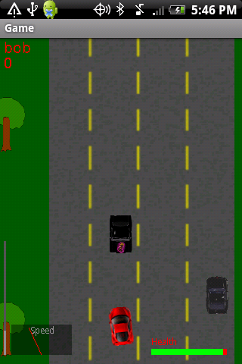
Interface
Player name
Player score
Health meter
Distance to Finish
Speedometer

Slide 7
Controls
Accelerate – Tilt Up
Brake/ Reverse – Tilt Down
Turn Left – Tilt Left
Turn Right – Tilt Right

Slide 8
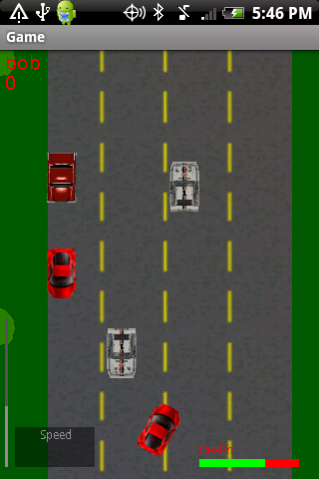
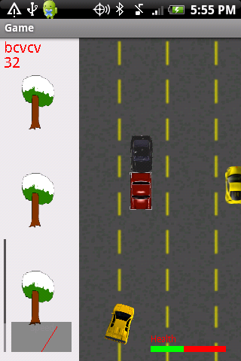
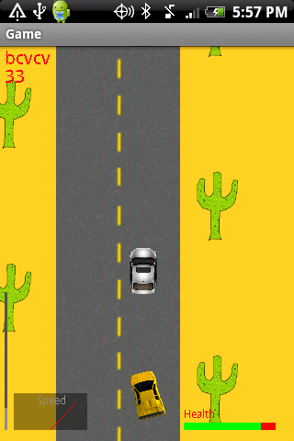
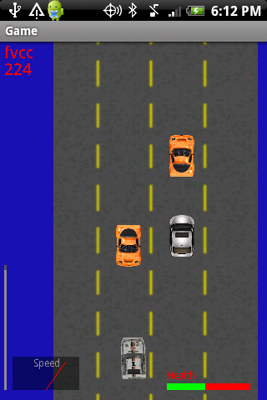
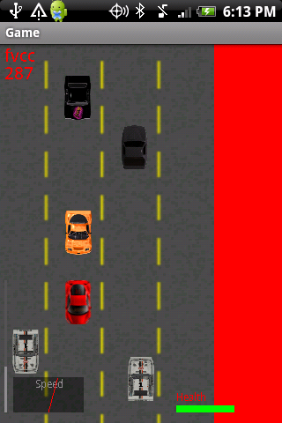
Levels
There are 5 different levels. Each one is harder than the last.
Level 1
Grass
Level 2
Snow
Level 3
Desert
Level 4
Water
Level 5
Lava

Slide 9
Scoring
Health plays a very large role in the players score.
It’s easy to go through the levels, but if you are aiming for a high score, you have to conserve as much health as possible.
The formula for scoring is:
If a player gets through a level in a short amount of time, but only has 10% of their health remaining, they will only get 10% of the points they earned.
(Time given – Time taken) * (Health / Max Health)

Slide 10
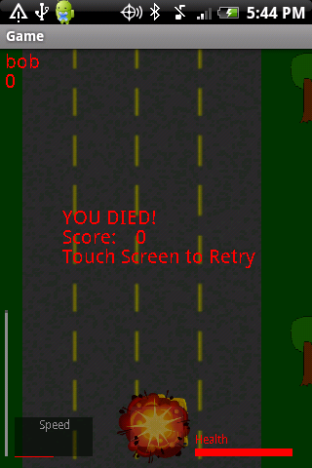
Losing
If a player takes too much damage in one level, their car will blow up and they will lose.
If they have a new high score when they lose, a message will be displayed.

Slide 11
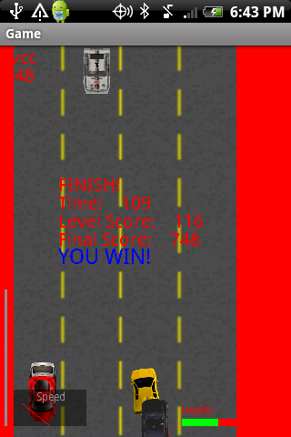
Winning
The last level is really hard. Traffic is heavy and the cars move fast. It’s also a lot longer than the other levels.
If a player beats the last level they get an extra 200 points added to their score, and the game ends.

Slide 12
THE END
I really enjoyed making this app over the semester.
The hardest part of making this game was optimizing it to run smoothly without being slow and jumpy. Fixing bugs was also tough.
I learned a lot about programming for the Android and I hope to learn more in the future.

